Slide 1
Evolution
Inferring adaptation in the wild

Slide 2
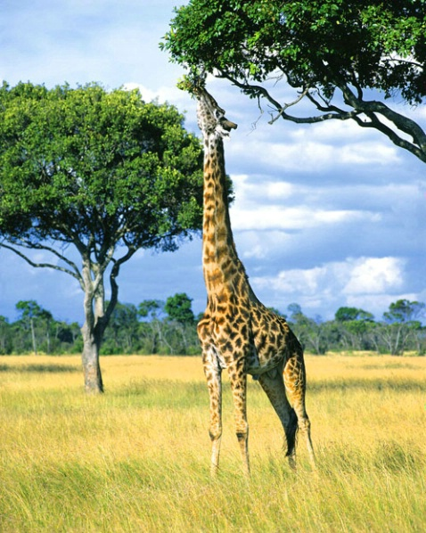
How do we infer adaptation?
Hypothesis 1
The long neck allows for foraging in places where other species can’t (foraging competition hypothesis)

Slide 3
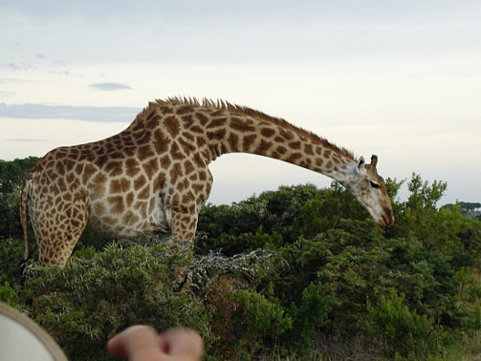
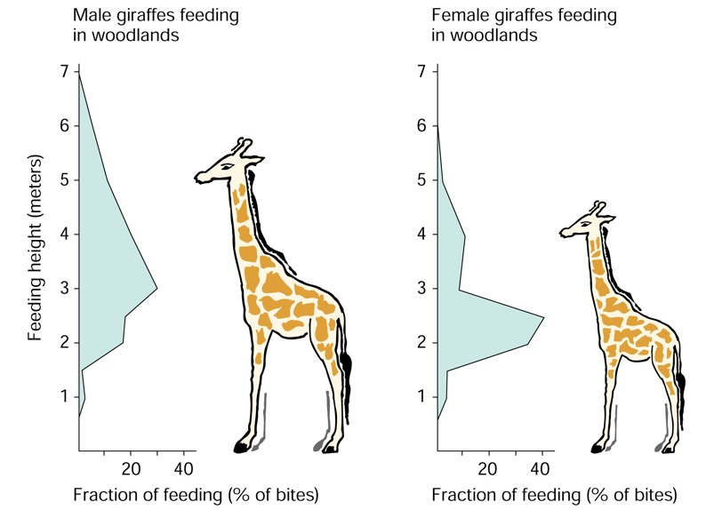
How do we infer adaptation?
Hypothesis 1
The long neck allows for foraging in places where other species can’t (foraging competition hypothesis)

Slide 4

The giraffe’s neck
Hypothesis 1
The long neck allows for foraging in places where other species can’t (foraging competition hypothesis)
Hypothesis 2
The long neck serves as a weapon in male combats for access to mates

Slide 5
The giraffe’s neck
Hypothesis 1
The long neck allows for foraging in places where other species can’t (foraging competition hypothesis)
Hypothesis 2
The long neck serves as a weapon in male combats for access to mates

Slide 6
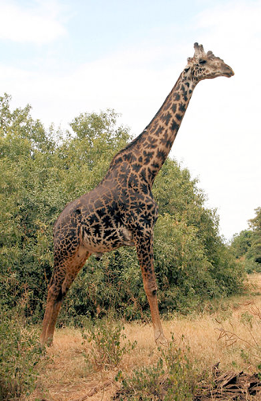
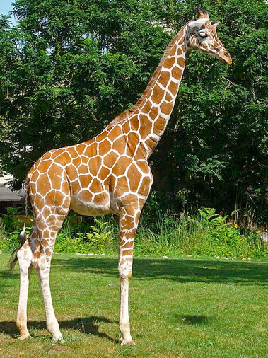
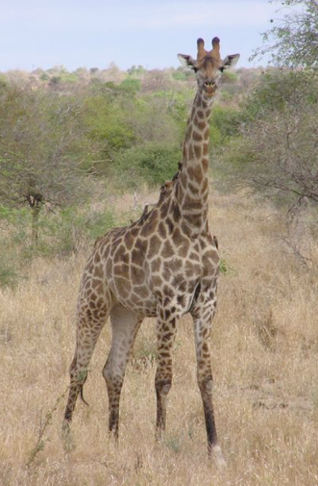
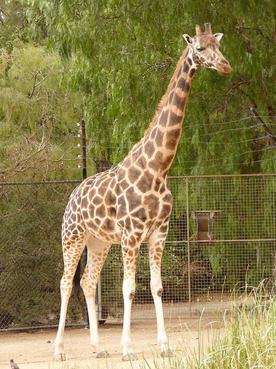
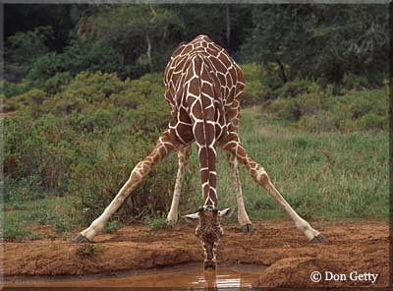
Just-so stories… are not science
Plausibility is no reason to prematurely accept a hypothesis about the adaptive significance of a trait
Not every trait of an organism or each use of a trait by an organism is adaptive!
Differences among populations are not always adaptive!
The origin of a traits is not necessarily reflected in its current use!
Adaptations are not perfect!
Constraints
Historical contingencies

Slide 7
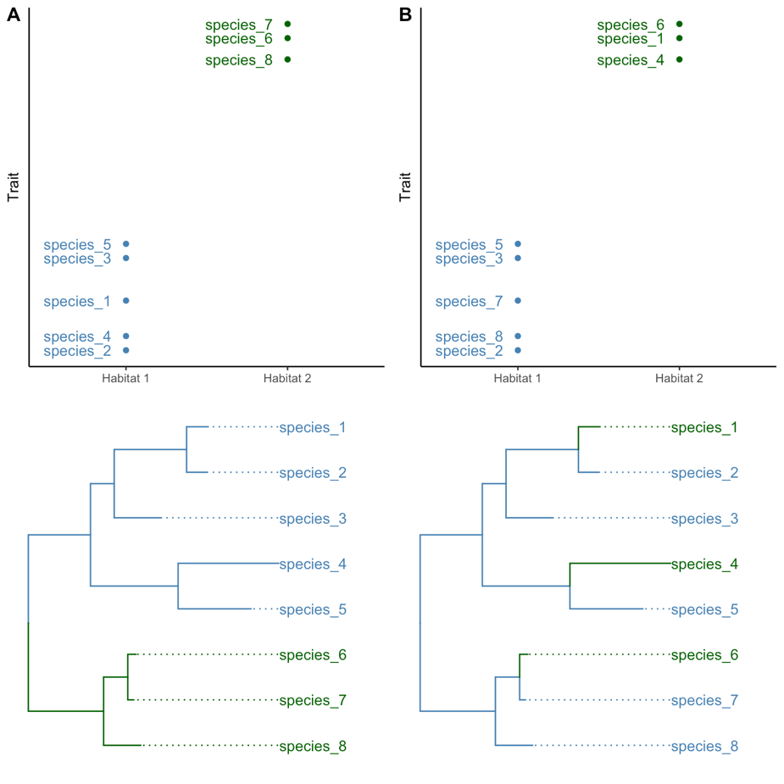
Ways of knowing about adaptation
Comparative studies look for trait-environment correlations
Among species comparisons need to consider phylogenetic relationship (phylogenetic comparative methods)
Convergent evolution is a signature of adaptation

Slide 8
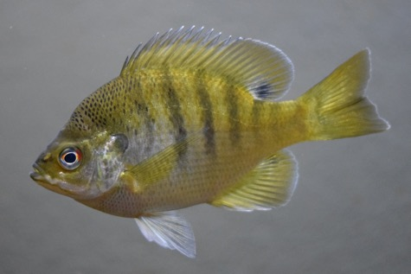
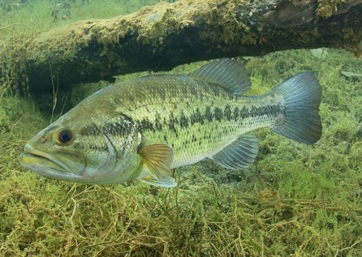
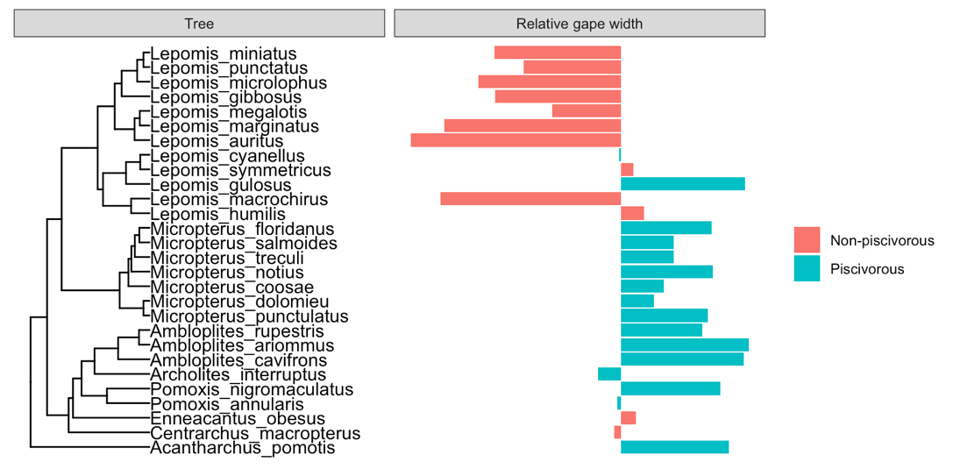
Ways of knowing about adaptation
Comparative studies look for trait-environment correlations
Among species comparisons need to consider phylogenetic relationship (phylogenetic comparative methods)
Convergent evolution is a signature of adaptation

Slide 9
Ways of knowing about adaptation
Comparative studies look for trait-environment correlations
Among species comparisons need to consider phylogenetic relationship (phylogenetic comparative methods)
Convergent evolution is a signature of adaptation

Slide 10
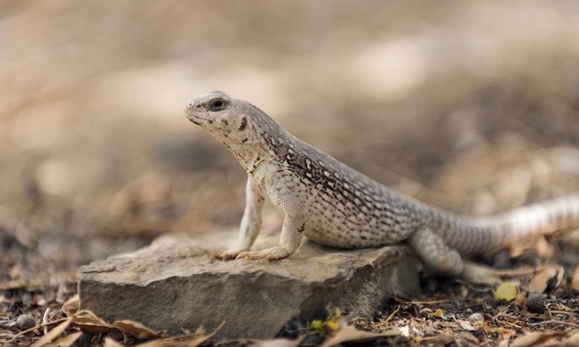
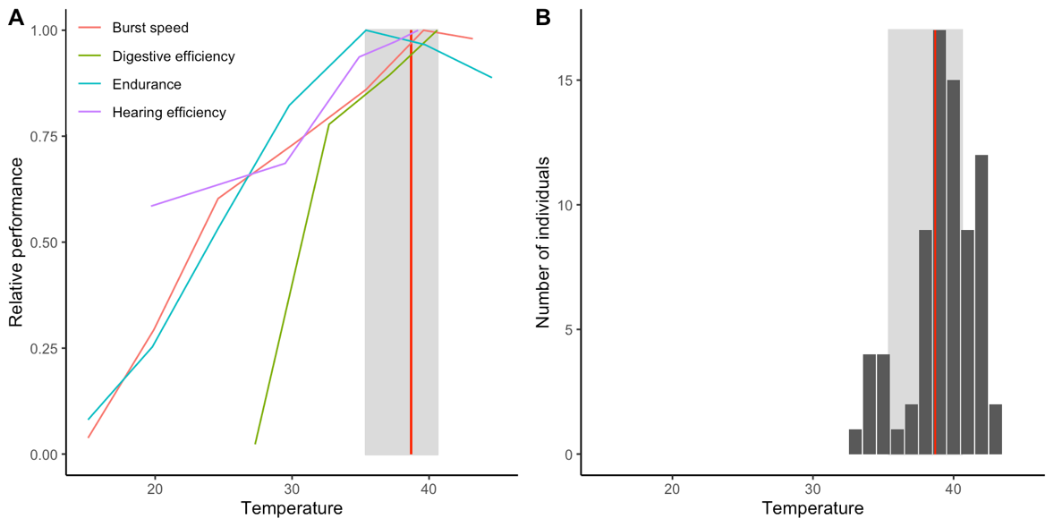
Ways of knowing about adaptation
Observation vs. experimentation
Ecological context vs. control over confounding variables
Correlation vs. causation
Both theory and experimentation are critical for the development of experiments!

Slide 11
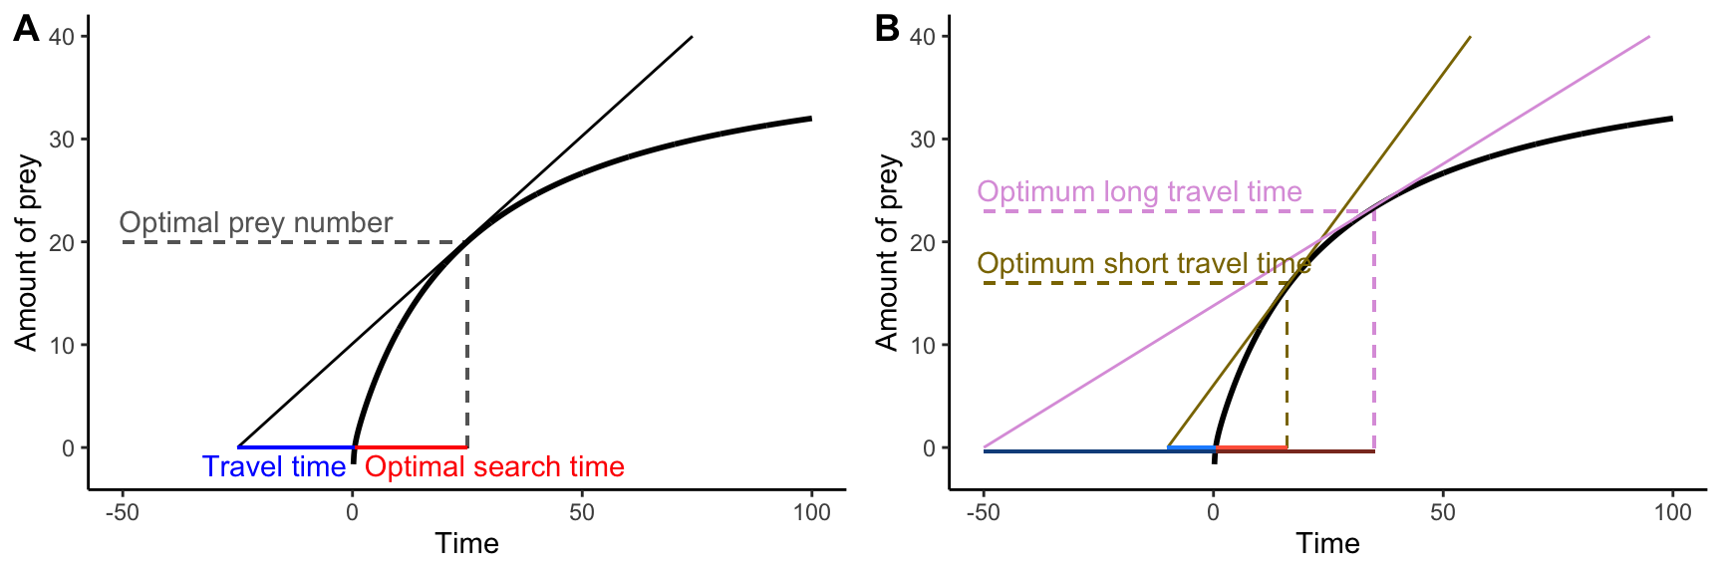
Ways of knowing about adaptation
Observation vs. experimentation
Ecological context vs. control over confounding variables
Correlation vs. causation
Both theory and experimentation are critical for the development of experiments!

Slide 12
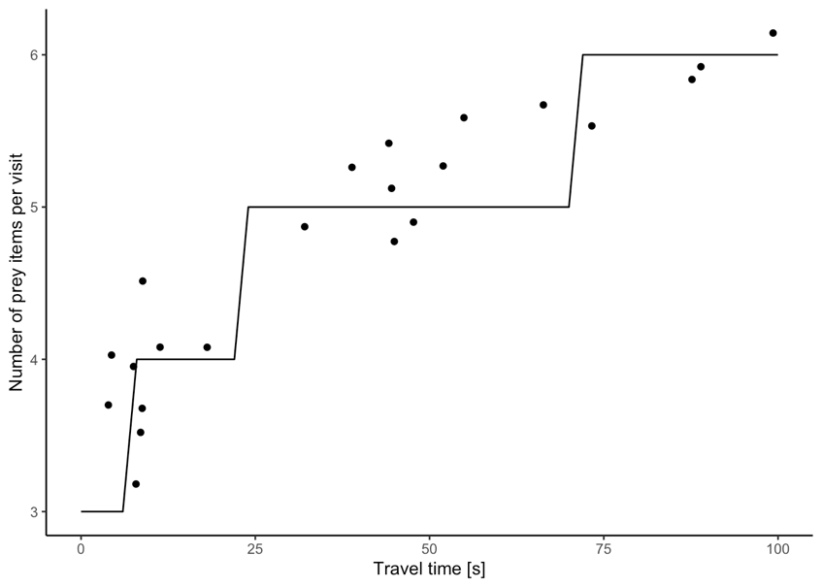
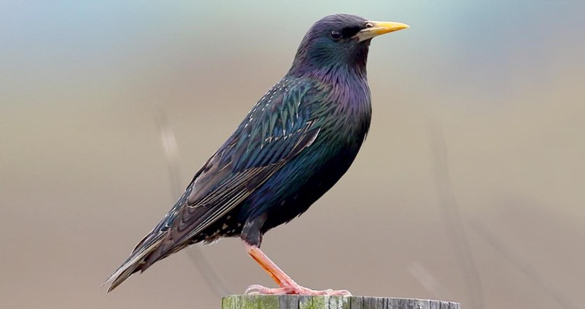
Ways of knowing about adaptation
Observation vs. experimentation
Ecological context vs. control over confounding variables
Correlation vs. causation
Both theory and experimentation are critical for the development of experiments!

Slide 13
Adaptive trait variation within species
There is significant variation within species, but what phenotypic traits represent adaptation to local environmental condition?

Slide 14

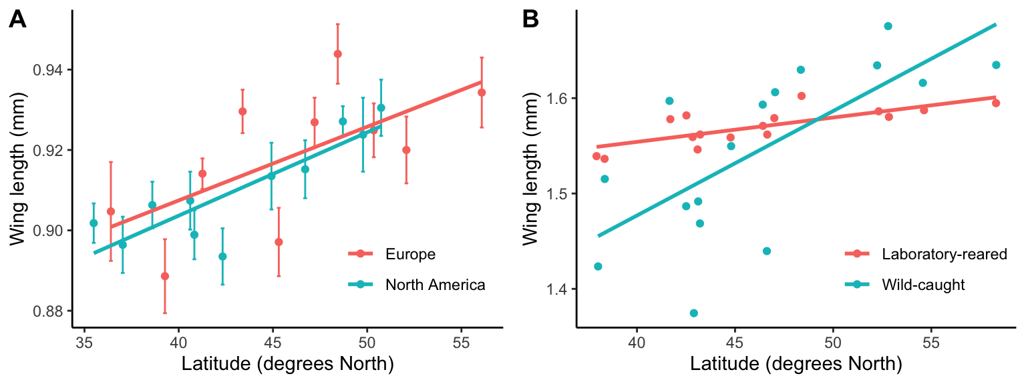
Adaptive trait variation within species
There is significant variation within species, but what phenotypic traits represent adaptation to local environmental condition?
Testing for local adaptation:
Trait-environment correlations

Slide 15
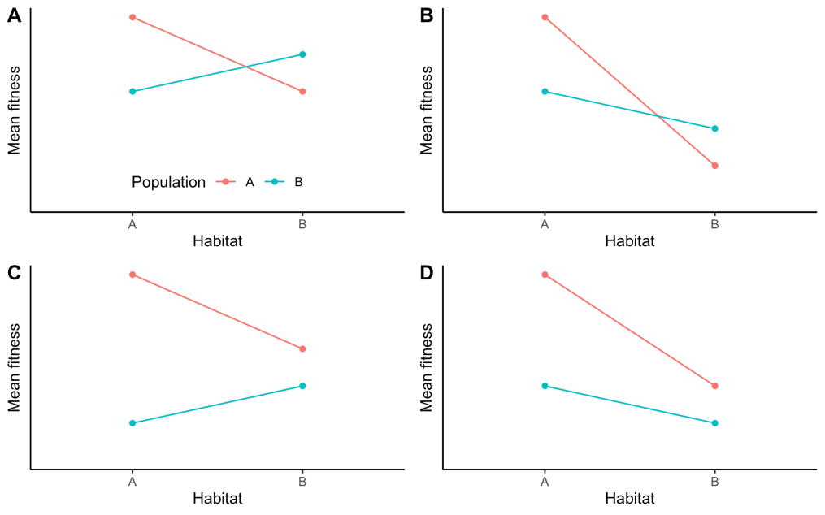
Adaptive trait variation within species
There is significant variation within species, but what phenotypic traits represent adaptation to local environmental condition?
Testing for local adaptation:
Trait-environment correlations
Contrasting the fitness of ecotypes under differential environmental conditions
Home vs. away
Local vs. foreign
Local vs. foreign
Home vs. away
Local vs. foreign
Home vs. away

Slide 16
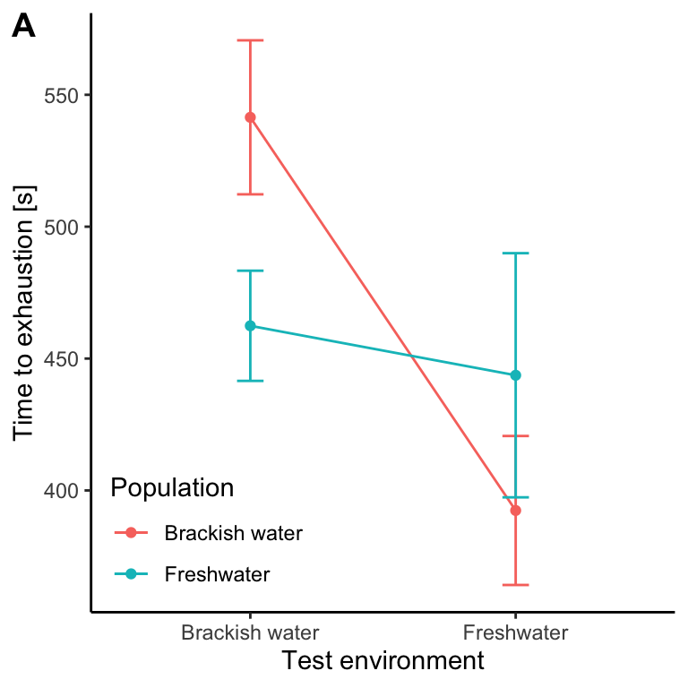
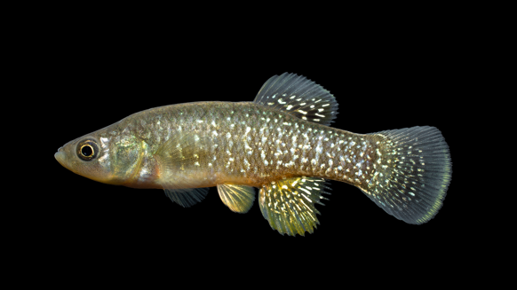
Adaptive trait variation within species
There is significant variation within species, but what phenotypic traits represent adaptation to local environmental condition?
Testing for local adaptation:
Trait-environment correlations
Contrasting the fitness of ecotypes under differential environmental conditions
Home vs. away
Local vs. foreign

Slide 17
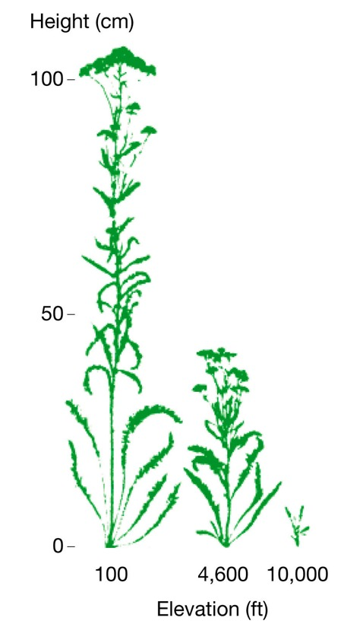
Adaptive trait variation within species
There is significant variation within species, but what phenotypic traits represent adaptation to local environmental condition?
Testing for local adaptation:
Trait-environment correlations
Contrasting the fitness of ecotypes under differential environmental conditions
Accounting for phenotypic plasticity
Ability of genotypes to produce different phenotypes
Analogous to the V_{E}

Slide 18
Phenotypic plasticity
Developmental plasticity
Cue during a critical period influences developmental trajectories
Non-reversible

Slide 19
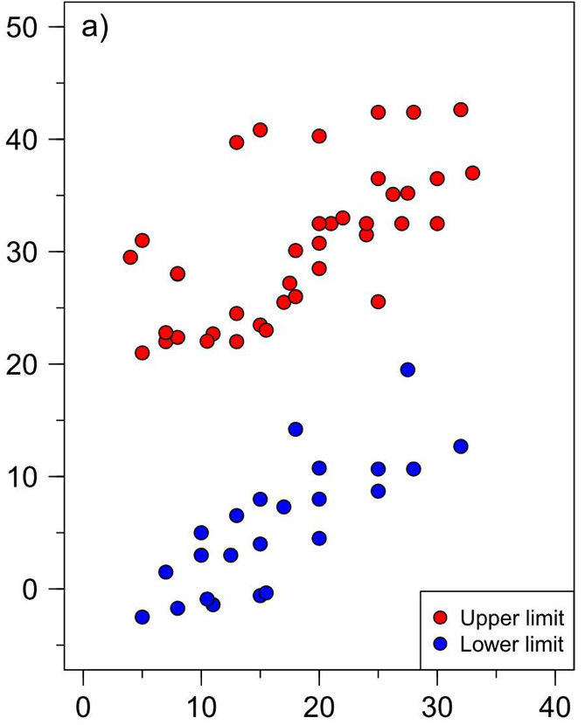
Phenotypic plasticity
Developmental plasticity
Cue during a critical period influences developmental trajectories
Non-reversible
Acclimation
Physiological changes that optimize organismal performance for a specific environment
Reversible
Thermal limit [degrees Celsius]
Acclimation temperature [degrees Celsius]

Slide 20
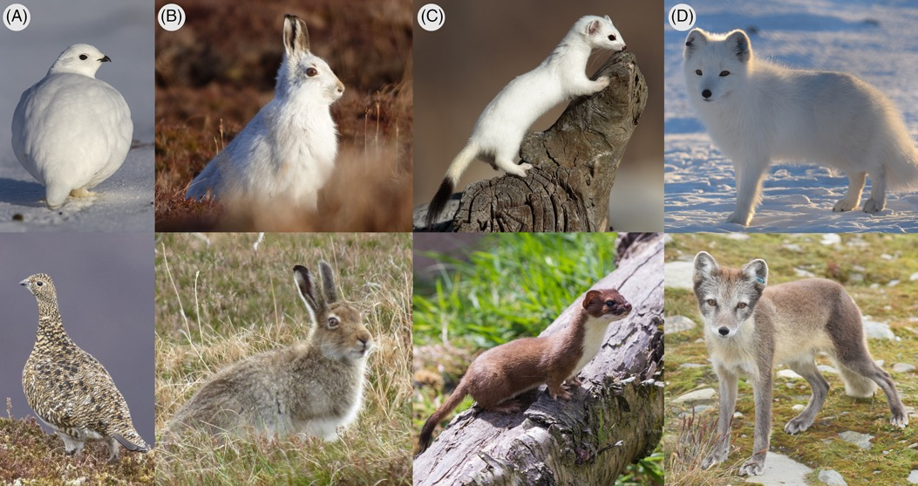
Phenotypic plasticity
Developmental plasticity
Cue during a critical period influences developmental trajectories
Non-reversible
Acclimation
Physiological changes that optimize organismal performance for a specific environment
Reversible
Seasonal plasticity
Predictable changes in phenotypic traits
Cyclical

Slide 21
Are plastic traits adaptive?
Plastic traits (e.g., white coat color in snowshoe hares) per se are not an adaptation!
Phenotypic plasticity itself is an evolvable trait (if there is genetic variation for plasticity)
Phenotypic plasticity may be adaptive, if it allows individuals to adjust their phenotype to increase their fitness in the environment in which they find themselves

Slide 22
Reaction norm
The pattern of phenotypic expression of a single genotype across a range of environments
V_{P} = V_{E}
Phenotype
Environment

Slide 23
Variation in phenotypic plasticity
The pattern of phenotypic expression of a single genotype across a range of environments
V_{P} = V_{E}
All genotypes have the same reaction norm
Can phenotypic plasticity evolve in this case?
Phenotype
Environment

Slide 24
Variation in phenotypic plasticity
The pattern of phenotypic expression of a single genotype across a range of environments
V_{P} = V_{E} + V_{G}
All genotypes have the same reaction norm, but there are also differences among genotypes
Can phenotypic plasticity evolve in this case?
Phenotype
Environment

Slide 25
Variation in phenotypic plasticity
The pattern of phenotypic expression of a single genotype across a range of environments
V_{P} = V_{E} + V_{G} + V_{GxE}
V_{GxE} is also called a gene-by-environment interaction; i.e., each genotype has a unique reaction norm
Can phenotypic plasticity evolve in this case?
Phenotype
Environment

Slide 26
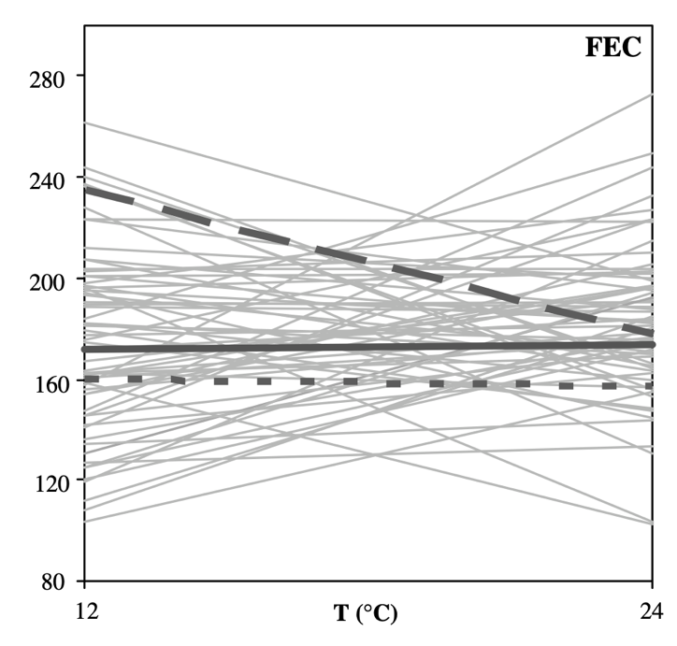
Variation in phenotypic plasticity in real life
Effects of cold acclimation of C. elegans fecundity
Reaction norms can themselves be viewed as a quantitative trait!

Slide 27
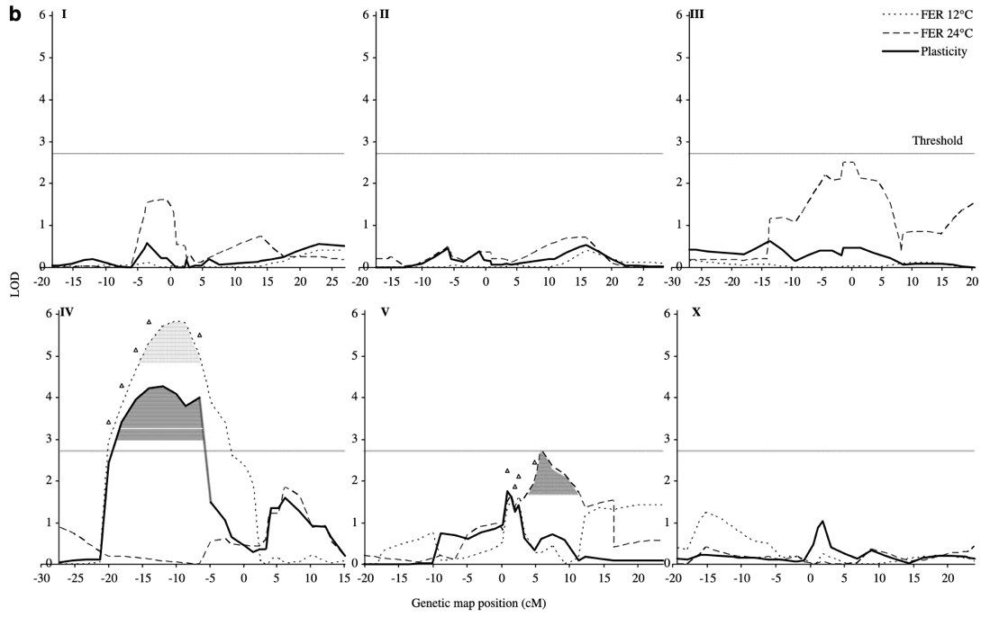
Variation in phenotypic plasticity in real life
Effects of cold acclimation of C. elegans age to maturity and fecundity
Reaction norms can themselves be viewed as a quantitative trait!
We can find the genes underlying phenotypic plasticity using QTL mapping

